Slide 1

Milestone 1: Problem, Dataset and Exploratory Analysis
Project by: Albina Cako and Joshua Dalphy
Course: CMLS1010
York University

Slide 2
Business Context
Sentiment Analysis is the process of determining whether text is either positive, negative or neutral
Valuable tool for companies and content creators to:
Gauge public opinion on their products/services
Perform market research
Monitor their reputation
In the entertainment industry sentiment analysis can be used on reviews to gauge the audience’s reaction to trailers, movies and tv shows.
Provides valuable data to studios
Studios can use the data to better understand their customers
Studios can use the data to improve or change content to better meet their customer’s expectations
https://www.ksat.com/entertainment/2020/08/07/nothing-new-to-watch-on-netflix-think-again/

Slide 3

Project Definition
Develop a machine learning model to perform sentiment analysis on movie reviews.
The model will take written reviews as inputs and classify them as either positive or negative.
Use the machine learning life cycle principles learned throughout this course and apply them to our project.
https://www.marketmotive.com/blog/discipline-specific/social-media/sentiment-analysis-article

Slide 4

Data Selection
https://usustatesman.com/movie-review-it/
The data used for the project is the Large Movie Review Dataset obtained from the ai.standford.edu website.
The data contains a total of 50,000 reviews divided evenly between testing and training folders.
The data is balanced and has 25,000 positive and negative reviews.
For the purpose of this project 7000 movie reviews were selected.
The dataset selected is balanced, containing 3500 positive and 3500 negative reviews.

Slide 5
Data preparation and cleaning
The dataset was normalized using text_normalizer.py
The cleaned dataset was saved into a csv file as Movie_Reviews_Clean.csv

Slide 6

Data exploration
Sample review (positive sentiment):
production quality cast premise authentic new england waterbury ct locale lush john williams score result 3 4 star collector item unfortunately get passable 2 star decent flick mostly memorable try bring art house style film mainstream small town locale story ordinary people genre well satisfy grownup jane fonda unable hide braininess enough make character believable wonder not post doctorate yale instead work dead end factory job waterbury robert diniros character bit contrived illiterate nice guy loser turn actually little help janes character 1990 version henry ford thomas edison genre successfully handle nobodys fool mid 90 year 2003 schmidt wish main stream studio would try stuff post adolescent reserve couple screen multi cinema complex effort give effort
https://www.datapine.com/blog/data-exploration-vs-data-presentation/
The dataset contained 2 columns: reviews and sentiments
The dataset contained 7000 rows, with 6988 unique reviews.
The sentiment column was either ”Positive” or “Negative” with a total of 3501 positive ones and 3499 negative ones.

Slide 7
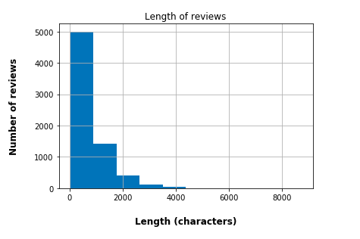
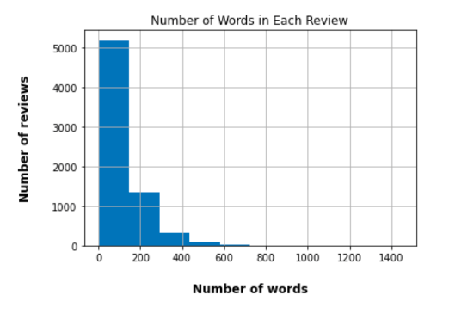
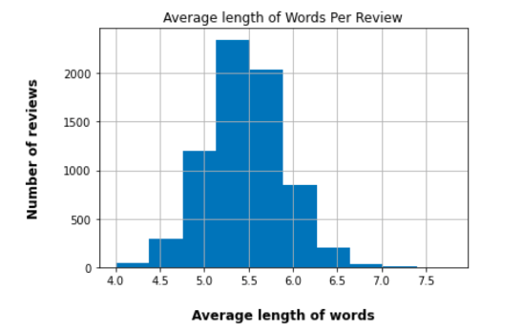
length analysis of reviews
Approx. 70 % of reviews were less then 1000 characters
The remaining 30% were between 1000 – 4000 characters.
Most reviews had 200 words or less, while the longest reviews were over 700 words.
The average length of word in each review was around 5 letters.

Slide 8
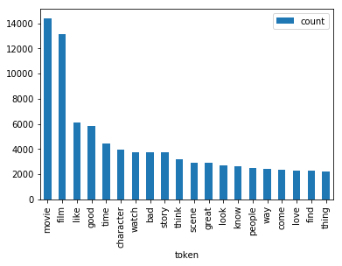
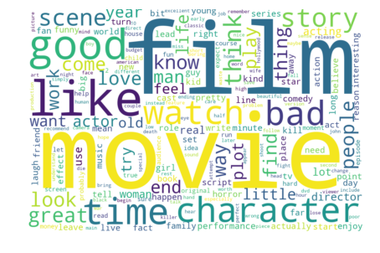
Exploring the dataset as a whole
The 20 most common tokens in the dataset
Wordcloud representation of most frequent tokens

Slide 9
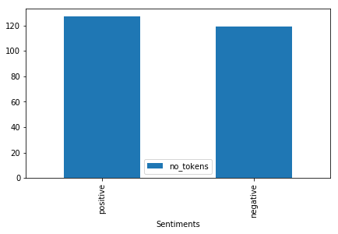
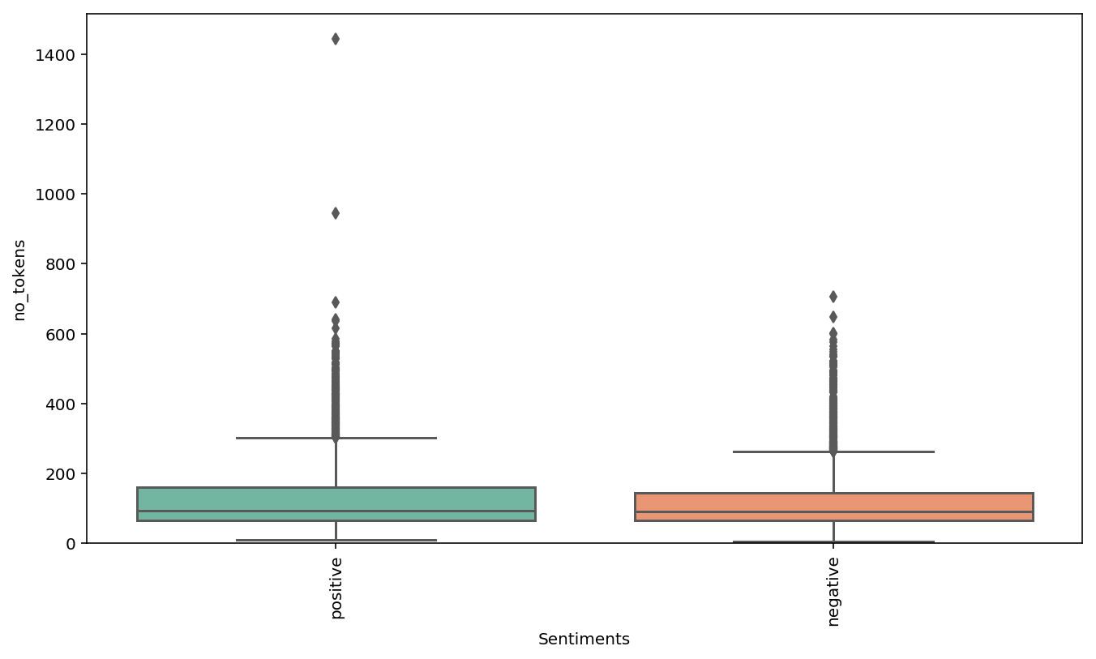
Exploring the dataset using sentiments
The positive reviews are slightly longer than the negative reviews
Outliers identified in both positive and negative reviews

Slide 10
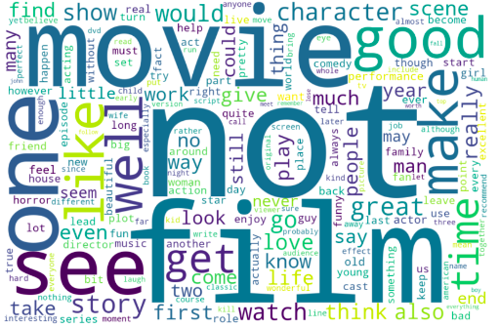
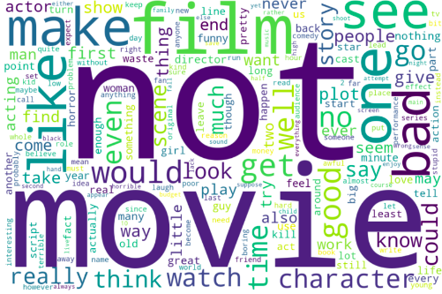
Exploring the dataset using sentiments: Common words
Positive reviews common words
Negative reviews common words
Difficult to distinguish sentiment
Approximately, 1.73 % of total tokens were common between positive and negative reviews
It might be beneficial to consider using bag of n-grams to better capture the sentiment of the review

Slide 11
References
Andrew L. Maas, Raymond E. Daly, Peter T. Pham, Dan Huang, Andrew Y. Ng, and Christopher Potts. (2011). Learning Word Vectors for Sentiment Analysis. The 49th Annual Meeting of the Association for Computational Linguistics (ACL 2011).

